Slide 1


Slide 2
Optimization of an autonomous vehicle dispatch system in an underground mine

Slide 3
Objectives
Develop a simulation to accurately simulate the movement and other activities of autonomous vehicles in an underground mine.
Determine evaluation criteria to optimize the dispatch strategies
Develop and implement dispatch strategies with the evaluation criteria in mind
Evaluate the improvement (if any) obtained by implementing the dispatch strategies, as compared to the baseline strategy

Slide 4
introduction
The project deals with the optimization of autonomous vehicle dispatch system for a block cave mine.
DSPATCH SYSTEM
DRAW POINT
TRANSFER POINT
CRUSHER

Slide 5
literature review: Need For Automation in underground mine
Conventional mining method for dispatching rely on intuition of supervisor.
Hazardous environment of underground mines and increase death rates
Mismanagement due to improper supervision
With autonomous vehicles an operator can be in a control room safely above ground, and production efficiency could increase

Slide 6
Need for optimization of autonomous vehicle
Draw point hang-ups
Vehicle breakdowns.
Trucks shutdowns
Frequent crusher shutdowns
Mismanagement in workings.
Pressure of increased productivity

Slide 7
Mining automation
Type of mining automation: computer-aided mining (CAM) and telerobotic mining (TRM).
Communication network connecting all the parts of the automated system for real-time monitoring and control
Information and data acquisition system (local sensors on vehicles, central database etc.).
Computerized database with open access for mine planning, control and maintenance systems.

Slide 8
Vehicle dispatch system in mining
Objective is to control a certain number of vehicles to complete tasks.
AGVs follow fixed routes
Active area in a mine is constantly shifting
Communication with satellite is inhibited
Sensors could be the possible solution..

Slide 9
Methodology-Optimization of autonomous vehicle
Parameter consider for formation of strategy:-
Controllable parameter
Vehicles speed
Direction of movement
Number of vehicle in the system
Fixed parameter
Maximum acceleration
Maximum speed
Fuel consumption
Capacity of crusher
Capacity of vehicle

Slide 10
Methodology-Optimization of autonomous vehicle
Optimization of autonomous vehicles can be done in two ways:-
Collision avoidance strategies
Strategies for dispatch system

Slide 11
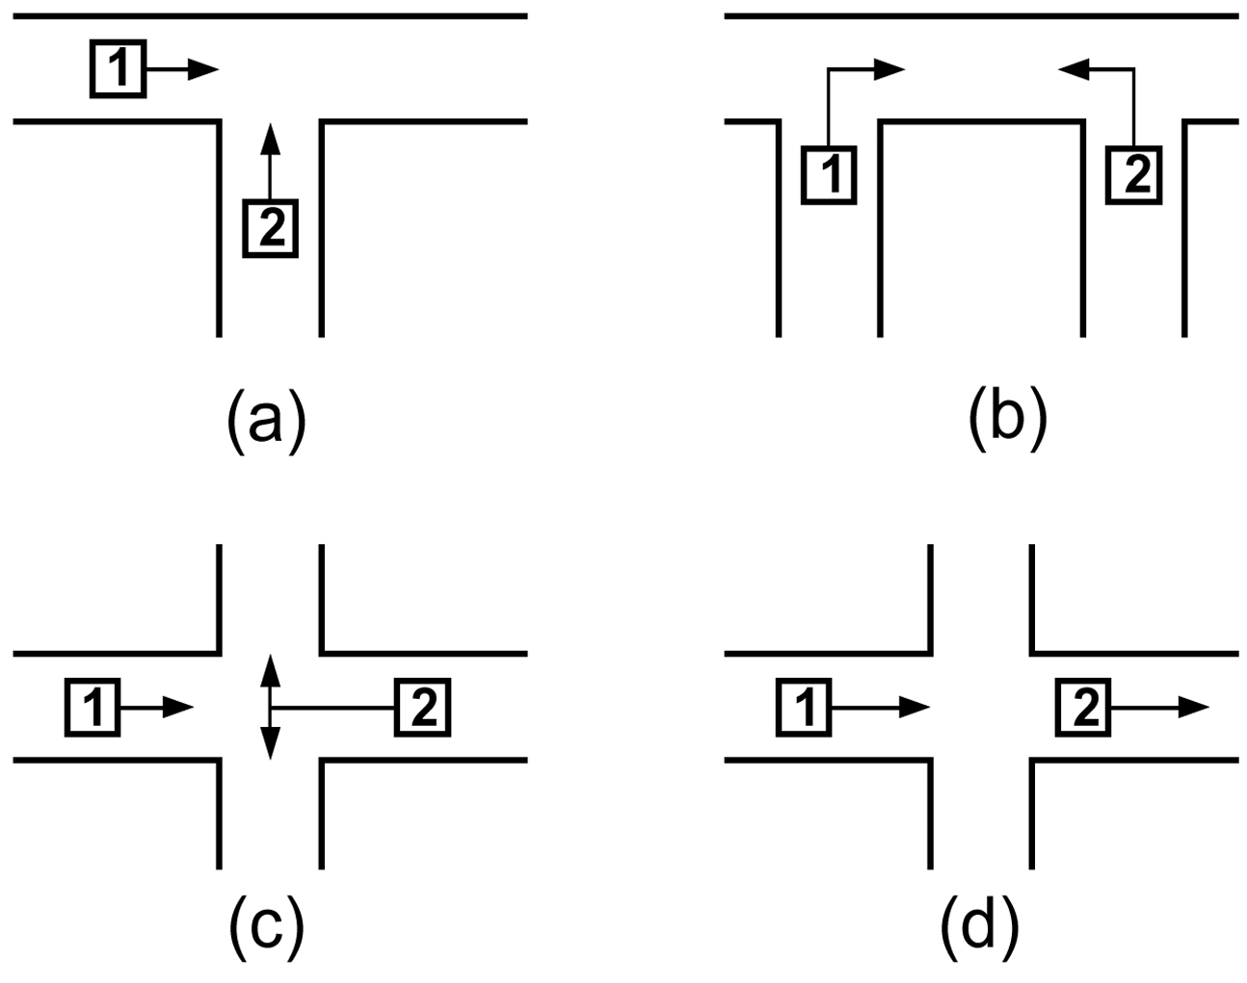
Collision avoidance strategies

Slide 12
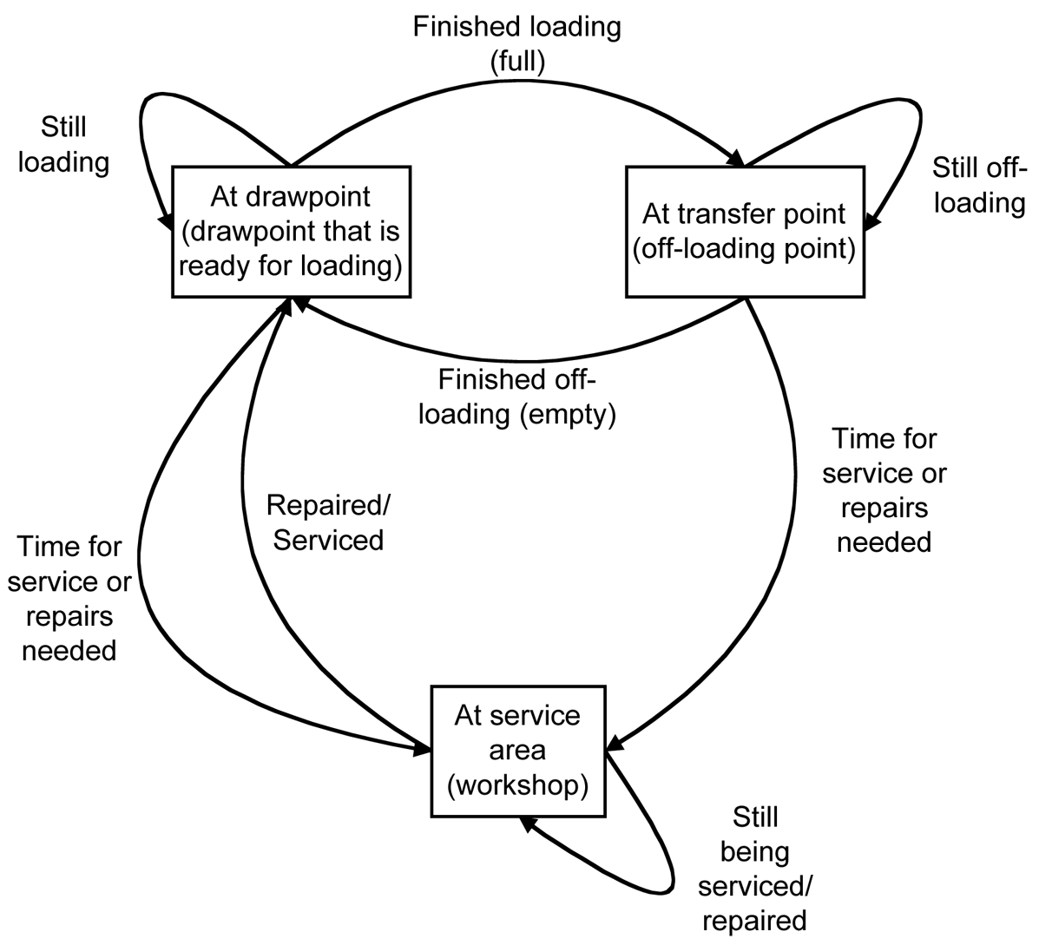
Strategicaly parameters for lhd dispatching

Slide 13
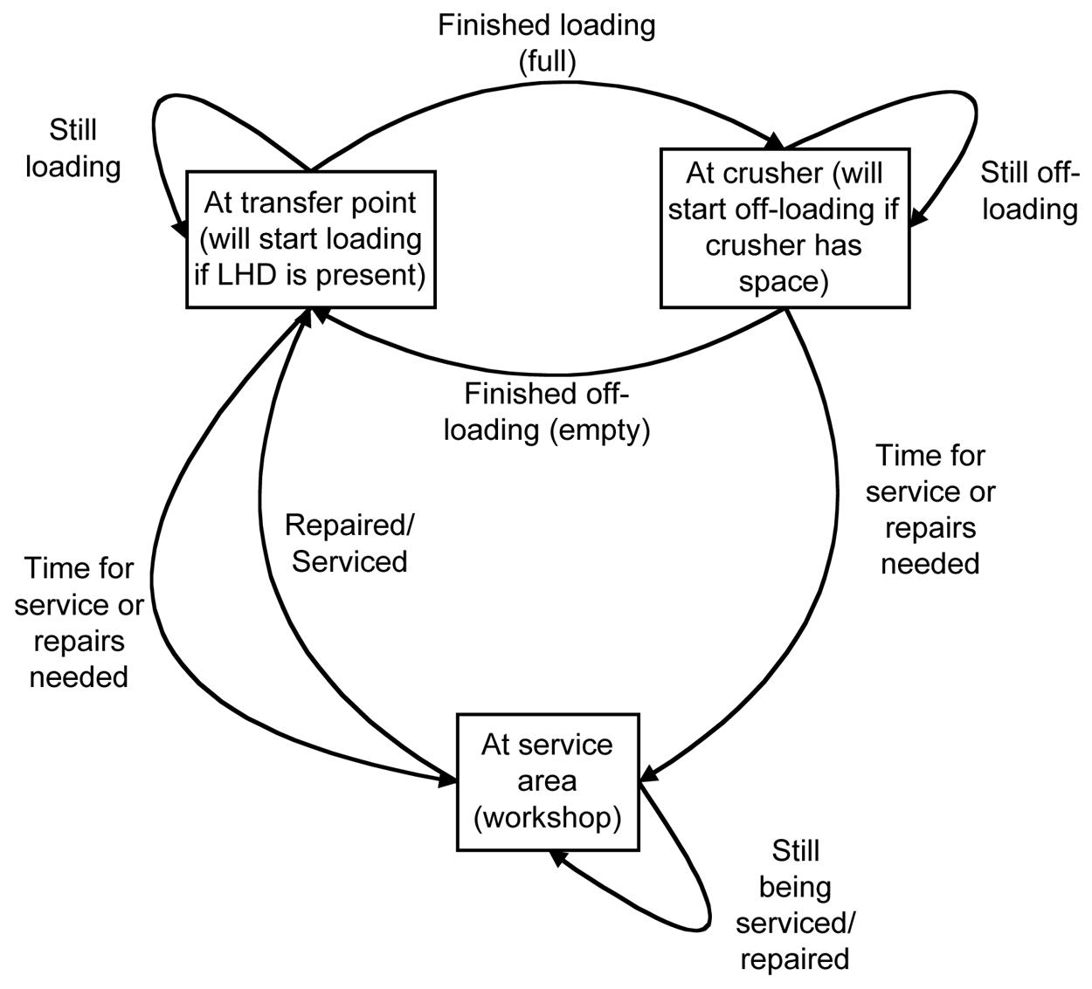
strategical parameters for truck dispatching

Slide 14
SIMULATION MODEL
The goal of the simulation is to model the real-life system of vehicles in an underground mine as close as possible.
Active area in mine will shift with time.
In a real-life system however, a lot of unpredictable factors play a role,but these factors are very hard, and sometimes impossible, to model accurately.
Thus stress is laid to develop the simplest model that is adequate to determine the desired outcome.

Slide 15
ASSUMPTIONS
The active area that is simulated consists of 7 tunnels with 15 drawpoints on both sides of each tunnel
Secondary blasting, in a specific tunnel, is done when 55% or more of the drawpoints in that tunnel are inactive due to hangups, or drawpoint has been inactive for more than 3 days.
During secondary blasting the tunnel is closed for production until all the drawpoints are active again. There is also a waiting period, of about 60 minutes, after blasting before production vehicles can re-enter the specific tunnel
The crusher is switched off if it stays empty for more than 12 minutes
Limit on the amount of ore that can be drawn daily is 200mm of solid rock per day.

Slide 16
Lhd parameter
PARAMETER | MINIMUM | TYPICAL | MAXIMUM
Bucket load |  | 9 ton
fuel tank |  | 450 ltrs
Load delay | 0.5 minutes | 0.6 minutes | 0.75 minutes
Off-load time | 0.25 min | 0.33 min | 0.45 min
Acceleration empty |  | 0.4m/s^2
Acceleration full |  | 0.35m/s^2
Deceleration |  | -1m/s^2
Max speed rim Tunnel |  | 15km/h
Max speed extraction tunnel |  | 16km/h
Max speed of drawpoint tunnel |  | 4km/h
Turn speed |  | 4km/h
Max speed limit in transfer area |  | 16km/h
Refuel time |  | 13 min
Service interval |  | 125 hours
Service duration | 240 min | 360 min | 600 min
MTBF | 40 h | 45 h | 60 h
MTTR | 1.5h | 2h | 2.5h
FUEL CONSUMPTION | 40l/h | 45l/h | 50l/h

Slide 17
Truck parameter
PARAMETER | MINIMUM | TYPICAL | MAXIMUM
Speed limit |  | 25km/h
Intersection speed Limit |  | 5km/h
Safety zone |  | 10 meter
Off-load time |  | 38 sec
Acceleration empty |  | 0.49m/s^2
Acceleration full |  | 0.35m/s^2
Deceleration |  | -1m/s^2
Bucket size |  | 45 ton
Fuel tank |  | 700 ltr
Refuel time |  | 13 min
Fuel consumption | 70l/h | 80l/h | 90l/h
Service interval |  | 125 hours
Service duration | 240 min | 360 min | 600 min
MTBF | 40 h | 45 h | 60 h
MTTR | 1.5h | 2h | 2.5h

Slide 18
Crusher parameters
PARAMETER | MININMUM | TYPICAL | MAXIMUM
capacity |  | 140 ton
Minimum level |  | 30 ton
Crush rate |  | 800 t/h

Slide 19
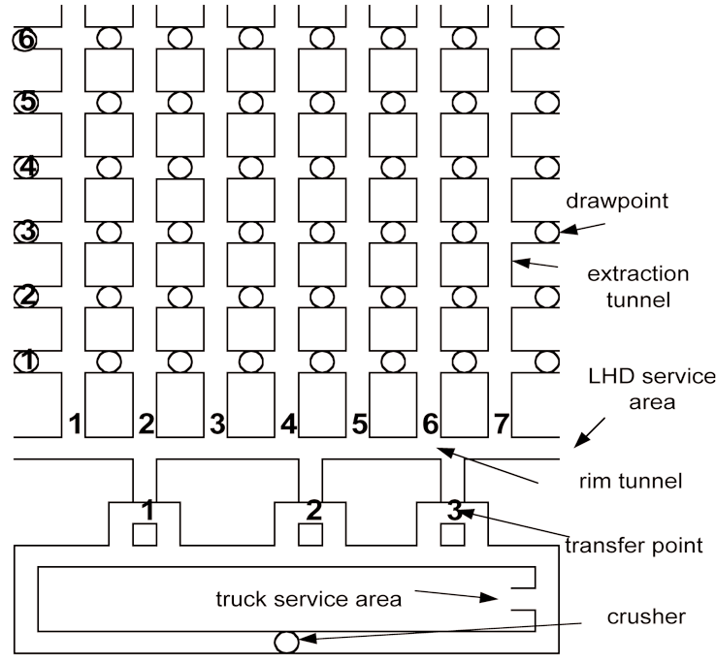
Simulation environment: the tunnel outlines can be seen and the circles represent draw points. The circle at the bottom represents the crusher, and the loop at the bottom is the tunnel connecting the transfer points with the crusher (this is not drawn according to scale).

Slide 20
Details of mine layout
Figure represent detailed representation of the simulated LHD environment, including dimension

Slide 21
Figure represent detailed representation of the simulated truck environment, including dimensions.

Slide 22
Strategies for dispathing
All the strategy is run for the equivalent of one week of production i.e 5 days, with 3 shifts of 8 hours each per day.
Zero state indicates an even ore level, with no ore loaded from any draw point, and an empty crusher level.
The main objective of the different dispatching strategies is therefore to maximize the total tons produced.
Another important objective specific to a block cave mine, is to keep the ore level above the drawpoints as even as possible.
last objective of the simulated dispatching strategies is to minimize the number of crusher shutdowns.

Slide 23
Strategy 1
The first strategy is based on current dispatching strategies and will be used to compare other strategies.
Each LHD is assigned to a specific tunnel and has only one LHD assigned to it.
The LHD sequentially visits each active drawpoint in its assigned tunnel. After each visit to a drawpoint the LHD visits a transfer point one closest to the tunnel that the LHD is assigned to.
If an LHD has to be serviced, repaired or refuelled or tunnel becomes inactive because of hangups ,it moves to the service area.
The trucks move in clockwise direction around the loop connecting the transfer points and the crusher.If a truck is empty it moves to the nearest transfer point where no other truck is present.

Slide 24
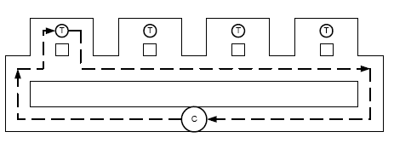
The figure gives a simple representation of the sequence in which the drawpoints are visited by an LHD. The figure only shows 3 drawpoints on each side of the tunnel. The number of drawpoints used in the simulation is 15 on each side of a tunnel. The arrows only indicate the sequence, and not the physical movement of the LHD. Between successive drawpoints the LHD visits a transfer point to unload.
The figure shows the direction of movement of the trucks around the loop connecting the transfer points and the crusher. The path actually indicates the movement of a truck that receives it load from transfer point 1 and then unloads in the crusher. The crusher is indicated with a ‘C’ and each transfer point is indicated with a ‘T’.

Slide 25
Strategy 2
This strategy is same as strategy 1. Each LHD is still assigned to a specific tunnel. However, the sequence in which the drawpoints are visited is reversed for every other tunnel thus keeping ore level even.
The movement of the trucks correspond exactly to that found in strategy 1.
The figure shows the drawpoint visiting sequence of three LHDs assigned to three adjacent tunnels. This is according to strategy 2. The figure again only shows a reduced number of drawpoints

Slide 26

Strategy 3
This strategy has same objective as strategy 2. The LHDs are still assigned to specific tunnels, but the sequence in which the drawpoints are visited is not fixed.
A cost function is used to determine the next drawpoint that an LHD visits after it has unloaded.
The drawpoint that gives the smallest value for the cost function is assigned as the LHD’s new destination.
The cost function contains the following two terms:-
The cost function then looks as follows:
J_{k}=T₁+T_{2,1}+T_{2,2}+T_{2,3}+T_{2,4}
With k =1,2,..., # drawpts _ in _ tunnel.Each drawpoint has four adjacent drawpoints and therefore term 2 is included four times in the cost function.

Slide 27
Strategy 4
This strategy focuses on the dispatching of the trucks. The LHD movements correspond to that found in strategy 1.
Aim of this strategy is to space the arrivals of the trucks at the crusher to minimize the crusher shutdowns.
Truck can only move to another transfer point, one ahead in the crusher loop if it is not occupied. If more than one transfer point satisfy this condition then truck will move to the closest one.
The decision to move to another transfer point, or not, is made when a truck has just received a load from an LHD.
If a truck is at the last transfer point in the crusher loop, and not yet full, then it must stay at that transfer point until it is full.

Slide 28
Strategy 5
Strategy 5 is basically the same as strategy 3 but in this case each LHD is not assigned to a specific tunnel. Truck movements correspond to that found in strategy 1.
The cost function is computed for all the active drawpoints in all the available tunnels. The drawpoint resulting in the lowest value for the cost function is chosen as the new destination of the LHD.
An available tunnel is one in which no LHD is present, and no LHD is already on its way to. It is also not closed for secondary breaking.
This strategy will obviously place a lot of strain on the collision avoidance algorithms
Transfer point are assigned to the specific tunnels.

Slide 29
combination
Some of the strategies focus on the LHD dispatching (strategy 1 to 3, and 5), and one focuses on the truck dispatching (strategy 4).
It makes sense to combine these strategies to determine if a more optimal solution can be found for the overall system. Strategy 4 is effectively a combination of strategy 1 and 4.
The combinations that remain are: strategy 2 + 4, strategy 3 + 4,4+5.thus these are also tested to compute the result.

Slide 30
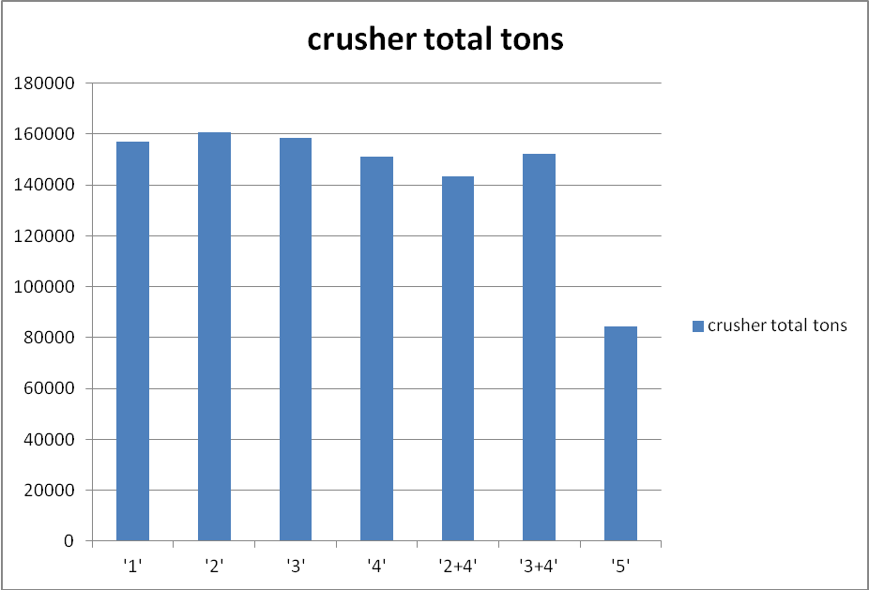
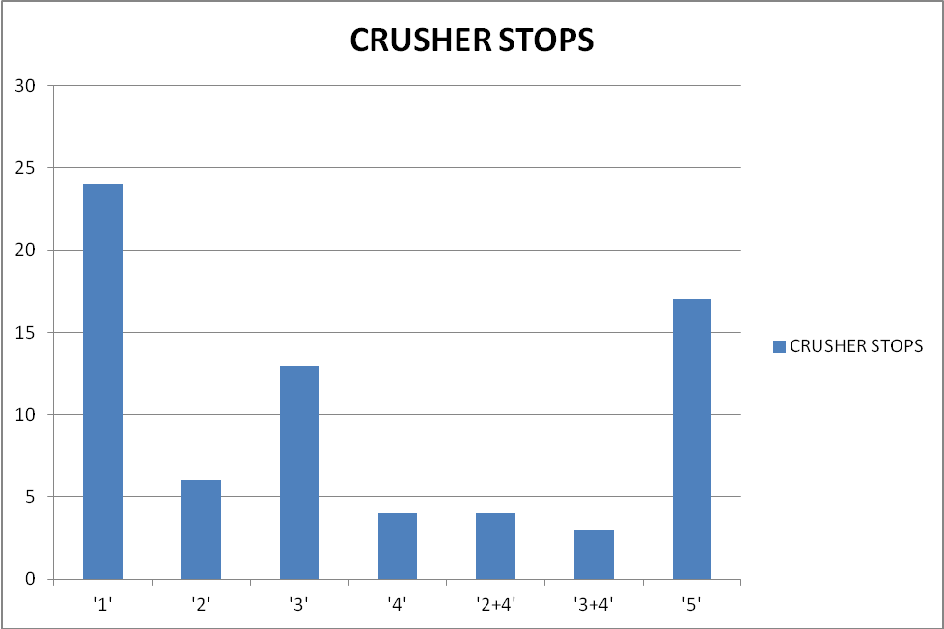
CRUSHER RESULT:

Slide 31
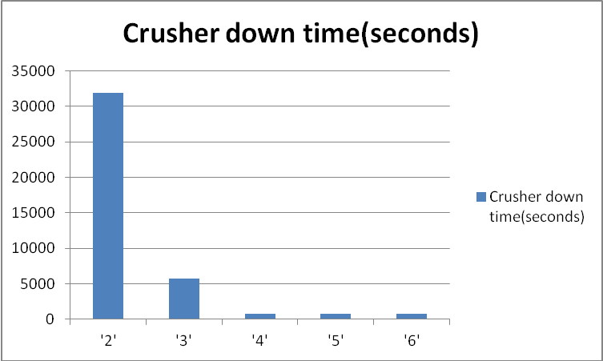
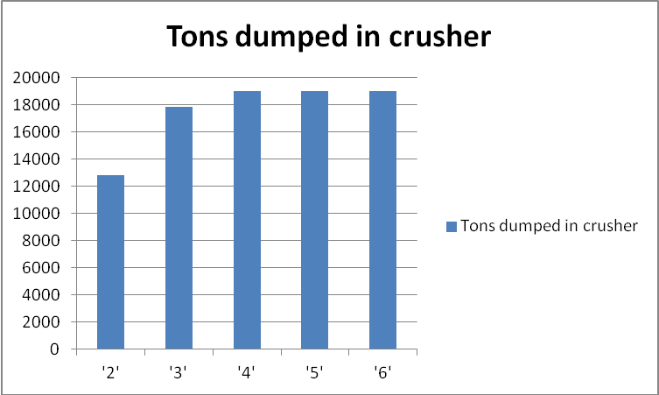
Optimal number of trucks for strategy 4:-

Slide 32
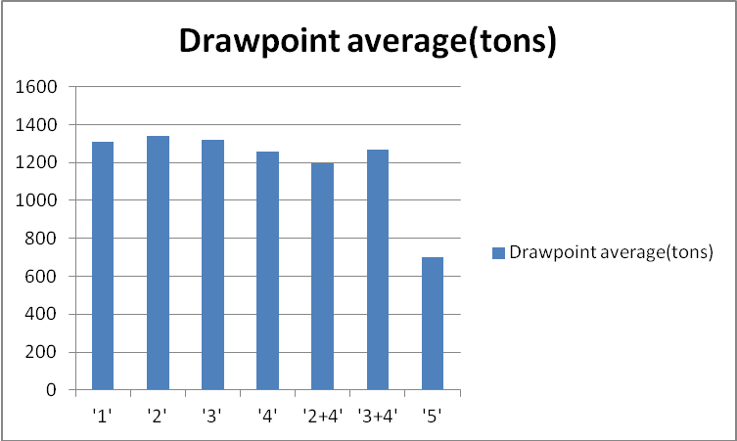
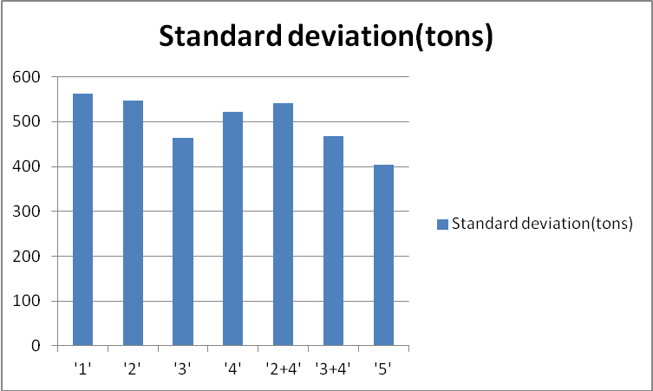
DRAWPOINT RESULT:

Slide 33
conclusion
strategy 2 performed the best in terms of total tons produced, and strategy 5 the worst.
Strategy 2 also produced one of the lowest number of crusher shutdowns.
Strategy 4 and their combinations produced low values for the total tons dumped in the crusher, but produced the least number of crusher shutdowns.
Optimal number of trucks are 4.
Strategy 3 being the best in keeping the ore level even and also achieving high level of production value.
Strategy 5 have lowest drawpoint deviation but it cannot be compared with other strategies as it production level is less.

Slide 34
Future Scope
Various assumptions were used to develop the simulation model , therefore possible future work exists in terms of refining the simulation to reflect a true system even more accurately.
Develop a model, which explicitly describes the processes in a mine in terms of money.the strategies will then be refined to maximize the profit.
Improve on the proposed strategies, and to investigate the physical implementation of these strategies more thoroughly.

Slide 35
references
www.smenet.org
www.Google.com
UNIVERSITY OF PRETORIA (p.sayamann)
PUKKILA, J. and SÄRKKÄ, P. Intelligent mine technology program and its implementation.
YAVIN, Y. Modelling the motion of an underground mining vehicle.
Venetia mine of de beers group in Botswana,South Africa.
Camisani-Calzolari F.R. (2004), “Modelling of an autonomous underground mine vehicle

